Slide 1
The JenaValve Trilogy™ Heart Valve System in High Surgical Risk Patients with Symptomatic, Severe Aortic Regurgitation: The ALIGN AR Trial
Vinod H. Thourani, MD and
Torsten P. Vahl, MD
On Behalf of the ALIGN AR Investigators
The Trilogy THV System is for Investigational Use Only in the United States and is Limited by Federal (or United States) law for this use.

Slide 2
Disclosure of Relevant Financial Relationships
Within the prior 24 months, I have had a relevant financial relationship(s) with the company(ies) listed below.
Nature of Financial Relationship | Company
Grant/Research Support | Abbott Vascular, Artivion, Atricure, Boston Scientific, Croivalve, Edwards Lifesciences, Jenavalve, Medtronic, Trisol
Consultant Fees/Honoraria | Abbott Vascular, Artivion, Atricure, Boston Scientific, Croivalve, Edwards Lifesciences
Executive Role/Ownership Interest | Dasi Simulations
All Relevant Financial Relationships have been mitigated.
Faculty disclosure information can be found on the app

Slide 3
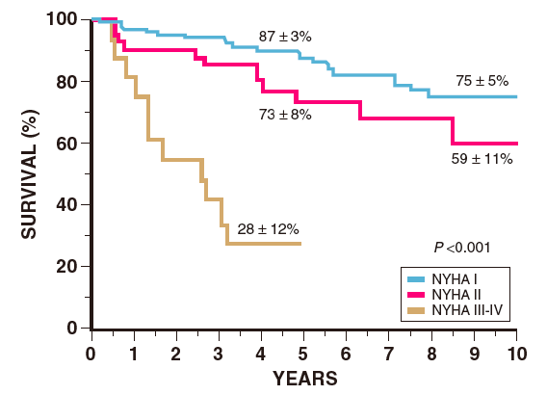
Background
Untreated severe, symptomatic AR is associated with high mortality especially in those with NYHA III/IV symptoms
SAVR remains the only recommended intervention for patients with native severe AR
Few treatment options for high surgical risk patients
Off-label use of TAVR devices for AR is associated with high rates of complications
>70% mortality at 5 years
Dujardin K, et al. Circulation. 1999;99:1851-1857.
Otto CM, et al. Circulation. 2021;143:e72-e227.
Thourani VH, et al. Structural Heart. 2021;5:608-618.
Haddad A et al., Clinical Cardiology 2019;42:159-166.

Slide 4
Purpose
Demonstrate the safety and effectiveness of the Trilogy Transcatheter Heart Valve amongst a group of patients with symptomatic ≥3+ aortic regurgitation who are high-risk for surgical aortic valve replacement

Slide 5
ALIGN AR Study Design
Multicenter, Non-blinded, Single Arm Evaluation of Patients with Symptomatic ≥3+ Aortic Regurgitation at High Risk for SAVR
Trilogy THV Implantation
Clinical Evaluation, Echocardiography, Functional and QoL Assessment at 30 Days, 6 Months, 1 Year and Annually up to 5 Years
30 Day Primary Safety Endpoint
1 Year Primary Efficacy Endpoint
Comparison with Prespecified Performance Goal

Slide 6
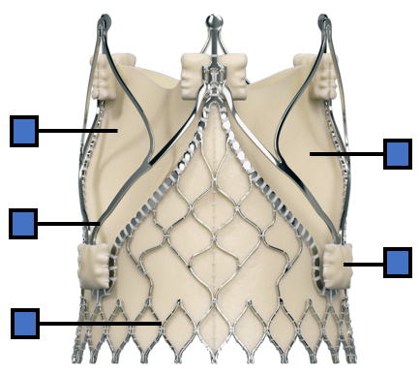
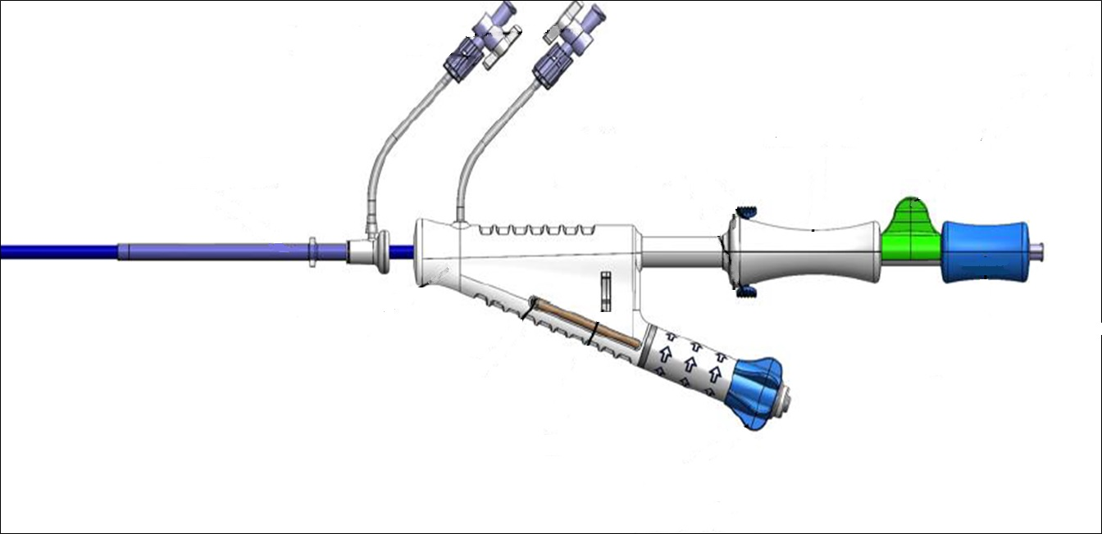
Trilogy THV System for Aortic Regurgitation
27-31 French Open Cell
Porcine Pericardial Tissue
Available in 3 sizes with a perimeter range from 66-90mm
Nitinol Frame
Locator
Flared Sealing Skirt
Controller
(Advance and Rotate Valve)
Preshaped Sheath
Catheter Deflector

Slide 7
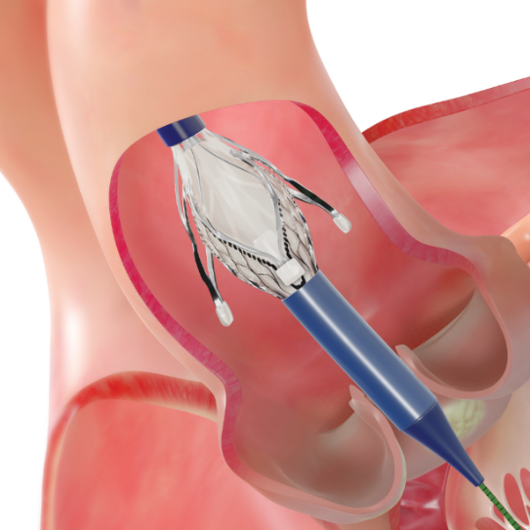
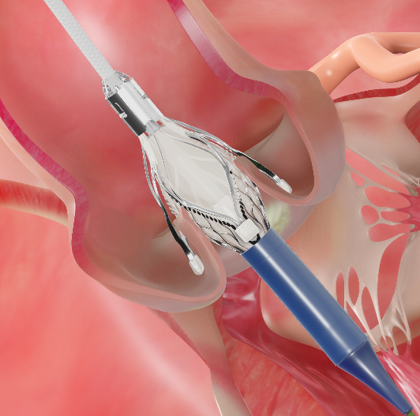
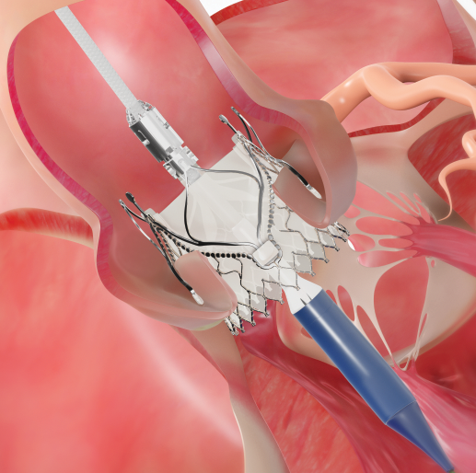
Trilogy THV in AR Anatomy
27-31F opening
Alignment
Positioning/Anchoring
Deployment
Aligns THV with native cusps
Locators “clip” onto native leaflets forming a natural seal and stable securement
Large open cells provide access to low coronaries
Flared sealing ring conforms to annulus

Slide 8
Study Organization
 | Investigator | Institution
Study Chair | Martin Leon, MD | Columbia University Medical Center
National Principal Investigators | Vinod Thourani, MD | Piedmont Heart Institute
National Principal Investigators | Torsten Vahl, MD | Columbia University Medical Center
Executive Steering Committee | Martin Leon, MD | Columbia University Medical Center
 | Raj Makkar, MD | Cedars Sinai Medical Center
 | Vinod Thourani, MD | Piedmont Heart Institute
 | Torsten Vahl, MD | Columbia University Medical Center
 | Stephan Baldus, MD | Heart Center Köln
 | Hendrik Treede, MD | University Heart and Vascular Center Mainz
CT Core Laboratory | Omar Khalique, MD | Cardiovascular Research Foundation
Echocardiography Core Laboratory | Nadira Hamid, MD | Cardiovascular Research Foundation
DSMB/CEC Chairperson | W. Douglas Weaver, MD | Henry Ford Health System
Notes:
8

Slide 9
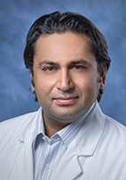
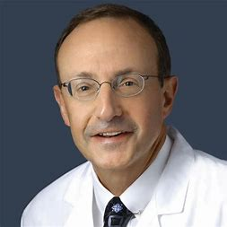
PIs of Top 5 Enrolling Sites
Raj Makkar, MD Cedars-Sinai Medical Center 43 Patients | Susheel Kodali, MD Columbia University Medical Center/NYP 33 Patients | Jamie McCabe, MD University of Washington 13 Patients | David Daniels, MD California Pacific Medical Center 13 Patients | Lowell Satler, MD Washington Hospital Center 10 Patients
180 patients were enrolled at 20 sites in the ALIGN-AR Trial
Notes:
9

Slide 10
Key Inclusion and Exclusion Criteria
Inclusion
Adult patients with moderate to severe or severe (Grade ≥3) AR assessed according to ASE criteria
NYHA Class II or greater symptoms
High-risk for SAVR defined by the Heart Team
Exclusion
Congenital unicuspid or bicuspid aortic valve
Aortic root diameter >5.0 cm
Previous prosthetic aortic valve
Mitral regurgitation >moderate
CAD requiring revascularization

Slide 11
Primary Endpoints
The primary safety endpoint was a composite at 30 days based on VARC-2 definitions
All-cause mortality, any stroke, major vascular complication, life threatening or major bleeding, new pacemaker, acute kidney injury, valve dysfunction and surgery or intervention related to the device
The primary efficacy endpoint was all-cause mortality at 12 months

Slide 12
Key Secondary Endpoints
Cardiovascular mortality
Disabling stroke
Hemodynamic valve performance
LV remodeling measured by echocardiography
NYHA Functional Class
Quality of life measured by the KCCQ instrument

Slide 13
Primary Safety Endpoint: Performance Goal Derivation
Performance Goal derived from contemporary high-risk AS TAVR trials reporting VARC-2 composite endpoints*
(REPRISE III, PORTICO IDE, SOLVE TAVR, n=1108)
Weighted Safety Composite Endpoint = 30.0%
Performance Goal Margin = 1.35
Performance Goal for 30-Day Composite Safety Endpoint = 40.5%
Performance Goal for 30-Day Composite Safety Endpoint = 40.5%
*Only the FDA or CE approved device cohorts were included in weighted composite endpoint derivation (investigational device cohorts excluded)

Slide 14
Primary Efficacy Endpoint: Performance Goal Derivation
Performance Goal for efficacy derived as a weighted average of 1-year mortality with conservative management according to NYHA Class
Class I/II
Class III/IV
Weighted Average
19.1% x 30%
+
34.7% x 70%
=
30.0%
Literature for conservative treatment of ssAR is limited, so weighted average reduced from 30% by 5%
Performance Goal for 1-Year Primary Efficacy Endpoint = 25.0%
Turk et al. Ann Thorac Surg. 2010;89:731-7.
Sampat et al. J Am Coll Cardiol.2009;54:452-7.
Fiedler et al. Heart. 2018;104:835-40.
Kamath et al. Circulation.2009;120:S134-8.

Slide 15
Study Methodology
The primary safety and efficacy endpoints are compared for noninferiority against the prespecified performance goals using the one tailed z-test with an α = 0.025
Each patient reviewed (including imaging studies) and accepted by multi-disciplinary Heart Team AND unanimous vote of case review board
Core lab review of all cardiac imaging
100% CEC adjudication of all major events using applicable VARC-2 definitions
5-year clinical and echocardiography follow-up planned in all patients

Slide 16
Screening and Patient Disposition (As Treated)
Patients Screened
(n=379)
CT Anatomic Criteria (n=45)
Moderate or Less AR (n=39)
Patients Ineligible (n=199)
Other Echocardiographic (n=8)
Other Clinical and Anatomic Criteria (n=107)
Patients Enrolled (n=180)
Trilogy THV Successfully Implanted (n=177)
Converted to SAVR (n=1)
Commercial TAVR implant (n=2)
1 Year Efficacy Population
180/180 (100%)
30 Day Safety Population
180/180 (100%)

Slide 17
Baseline Patient Characteristics
Demographics and Co-Morbidities |  | Vascular & Other Co-Morbidities
Age (years) | 75.5 ± 10.8 | Atrial Fibrillation | 40.6%
Female | 47.2% | Pulmonary Hypertension | 25.6%
BMI – kg/m² | 25.3 ± 6.1 | Prior Permanent Pacemaker | 16.1%
STS Score | 4.1 ± 3.4 | Left Bundle Branch Block | 5.6%
NYHA Class III or IV | 67.2% | Right Bundle Branch Block | 10.6%
Hypertension | 82.8% | Prior CABG | 11.1%
Diabetes | 14.5% | Prior PCI | 20.6%
Renal Insufficiency | 32.2% | Prior CVA | 10.6%
Frailty | 33.9% | Carotid Disease | 10.0%
Prior Endocarditis | 11.7% | Peripheral Arterial Disease | 17.8%

Slide 18
Baseline Patient Characteristics
Demographics and Co-Morbidities |  | Vascular & Other Co-Morbidities
Age (years) | 75.5 ± 10.8 | Atrial Fibrillation | 40.6%
Female | 47.2% | Pulmonary Hypertension | 25.6%
BMI – kg/m² | 25.3 ± 6.1 | Prior Permanent Pacemaker | 16.1%
STS Score | 4.1 ± 3.4 | Left Bundle Branch Block | 5.6%
NYHA Class III or IV | 67.2% | Right Bundle Branch Block | 10.6%
Hypertension | 82.8% | Prior CABG | 11.1%
Diabetes | 14.5% | Prior PCI | 20.6%
Renal Insufficiency | 32.2% | Prior CVA | 10.6%
Frailty | 33.9% | Carotid Disease | 10.0%
Prior Endocarditis | 11.7% | Peripheral Arterial Disease | 17.8%

Slide 19
ALIGN AR Patient Population
77 patients (42.7%) 80+ years with average STS 4.3%
36 patients (20.0%) 85+ years with average STS 4.6%
33.9% Classified as Frail
116 patients (64.4%) with 1+ Frailty measure (6MWT, Grip, Katz, BMI <20)
44 patients (24.4%) with 2+ Frailty measures
89 if include Hgb below threshold (49.4%)

Slide 20
Baseline Imaging Characteristics
 | %(n) or mean ± SD |  | mean ± SD
AR Severity Severe Moderate to Severe Moderate Not Evaluable | 64.4% (116) 31.7% (57) 2.8% (5) 1.1% (2) | Regurgitant Volume (ml) | 55.5 ± 17.2
 |  | LVESD (mm) | 39.6 ± 10.2
 |  | LVESV (ml) | 70.6 ± 38.9
Vena Contracta Width | 0.7 +/- 0.1 | LVEF (% ± SD) | 53.8 ± 11.4
Prominent Holodiastolic Flow | 46.7% (84) | LV Mass Index (g/m²) | 172.7 ± 61.8
Mean Gradient (mmHg) | 8.7 ± 6.6 | CT – Annulus Perimeter (mm) | 78.7 ± 8.9
Regurgitant Fraction (%) | 55.3 ± 12.9 | CT – Annulus Area (mm²) | 480.1 ± 101.4

Slide 21
Procedural Details
Variable | % (n)
General Anesthesia | 91.1%, (164)
Procedure Time | 71.8± 24.9 min
Contrast Volume | 110.0 ± 54.9 cc
Post-BAV Dilatation | 3.9% (7)
Trilogy Valve Implanted Large Medium Small | 57.2% (103) 20.0% (36) 22.8% (41)

Slide 22
Procedural Outcomes
Outcome | % (n)
In-procedural Death | 0
Annular Rupture | 0
Ventricular Perforation | 0
Coronary Obstruction | 0
Valve Embolization | 2.2% (4)
Aortic Dissection | 0.6% (1)
Femoral Access Site Intervention | 2.2% (4)
Success Technical Success Device Success Procedure Success | 95.0% (171) 96.7% (174) 92.8% (167)

Slide 23
Primary Safety Endpoint at 30 Days
Variable | % (n)
All Cause Mortality | 2.2% (4)
Cardiovascular Mortality | 2.2% (4)
Any Stroke Disabling Stroke Nondisabling Stroke | 2.2% (4) 1.1% (2) 1.1% (2)
Major/Life Threatening Bleeding | 4.4% (8)
Major Vascular Complication | 3.9% (7)
Acute Kidney Injury Stage 2 or 3 or Dialysis (7 Days) | 1.1% (2)
Surgery/Intervention Related to the Device | 2.8% (5)
New Pacemaker Implantation Pre-existing PPM | 24.0% (36) 16.7% (30)
≥ Moderate Paravalvular Regurgitation | 0.6% (1)
Total | 26.7% (48)

Slide 24
Primary Safety Endpoint at 30 Days*
Enrolled Population
^{N=180}
40.5% prespecified non-inferiority margin
Rate 26.7%
Upper 1-sided 97.5% CI
34.1%
P_{non-inferiority} < 0.0001
Non-inferiority criteria met for primary safety endpoint
*Composite of 30 day all-cause mortality, all stroke, life-threatening/major bleeding, major vascular complications, AKI ≥ 2 or dialysis, valve intervention, new permanent pacemaker, ≥ moderate PVR

Slide 25
Primary Efficacy Endpoint at 1 Year*
Enrolled Population
^{N=180}
25% prespecified non-inferiority margin
Rate 7.8%
Upper 1-sided 97.5% CI
12.3%
P_{non-inferiority} < 0.0001
Non-inferiority criteria met for primary efficacy endpoint
*All-cause mortality

Slide 26
New Pacemaker Implant Rate By Tercile of Enrollment
Patients 1-60
Patients 61-120
Patients 121-180

Slide 27
Reasons for New PPM Rate Decrease
New pacemaker implant rate exceeded 20% in the trial but varied according to year of enrollment
Lower rates were observed at the end of the trial likely related to:
Change in insertion technique placing locators above the nadir of native valve cusps
Reduction in oversizing
Evolution in management of periprocedural conduction abnormalities

Slide 28
Hemodynamic Valve Performance
²
*AVA (cm²)

Slide 29
Paravalvular Regurgitation

Slide 30
LV Remodeling
p<0.0001
p<0.0001
millimeters
milliliters
p-value for comparison of baseline to 1 year using paired t-test

Slide 31
LV Mass
p<0.0001
p<0.0001
grams
grams/m²
p-value for comparison of baseline to 1 year using paired t-test

Slide 32
NYHA Functional Class

Slide 33
Quality of Life: KCCQ-OS
p<0.0001

Slide 34
The ALIGN AR Trial Conclusions (1)
In a population of symptomatic patients with ≥3+ aortic regurgitation at high surgical risk, TAVR using the Trilogy THV:
Achieved safety outcomes that met the 30-day performance goal (26.7%, p<0.0001)
Achieved an efficacy outcome for all-cause mortality that met the 12-month performance goal (7.8%, p<0.0001)
Among safety endpoints, the rate of new pacemaker implantation was 24.0% and declined during the course of the trial due to changes in implant technique and oversizing strategy

Slide 35
The ALIGN AR Trial Conclusions (2)
Trilogy THV performance was excellent with:
Large EOA and low transvalvular gradients
Low paravalvular regurgitation (0% ≥ Moderate at 1 year)
Echocardiography demonstrated significant improvement in LV remodeling
Patients reported sustained improvement in QoL and heart failure functional status through 1 year

Slide 36
The ALIGN AR Trial Clinical Implications
The TRILOGY THV system provides the first dedicated TAVR option for symptomatic patients with ≥3+ AR who are at high risk for surgery and is well positioned to become the preferred therapy upon approval for this population
The Trilogy THV System is for Investigational Use Only in the United States and is Limited by Federal (or United States) law for this use.

Slide 37
The ALIGN AR Trial
The study chair, principal investigators, executive steering committee and sponsor express our deepest gratitude to all Trilogy investigators in the US, Germany, Netherlands, and New Zealand, their research coordinators, CRB/CEC/DSMB members and to the patients who have made substantial contributions to improve the care of patients with AR
The Trilogy THV System is for Investigational Use Only in the United States and is Limited by Federal (or United States) law for this use.

